Slide 1





MARKET ATTRACTIVENESS ANALYSIS
for Global Business Expansion
Evaluating expansion readiness using macroeconomic strength, productivity, and human capital
GDP & GDP per capita
Human capital
Labour productivity
Investment rate & TFP
Data source: Penn World Table (PWT 11.0)
Objective: Identify countries with the strongest foundation for sustainable business expansion. Attractiveness should be assessed using multiple indicators, not GDP alone.
INSIGHT The most attractive markets combine scale, productivity, talent quality, and purchasing power.
1

Slide 2


Problem Statement, Research Question, and Hypotheses
Why GDP alone is not enough for market selection
The Problem
Hypotheses
Multinational firms need stronger screening criteria before entering new markets
GDP alone does not capture consumer power, workforce quality, or operating efficiency
Research question:
Which macroeconomic indicators best explain market attractiveness?
H0 There is no significant relationship between GDP and GDP per capita, human capital, labour productivity, investment rate, and total factor productivity
H1 Countries with higher values on these indicators tend to achieve stronger economic performance and are more attractive for expansion
INSIGHT A balanced KPI framework improves decision quality versus a size-only approach.
2

Slide 3
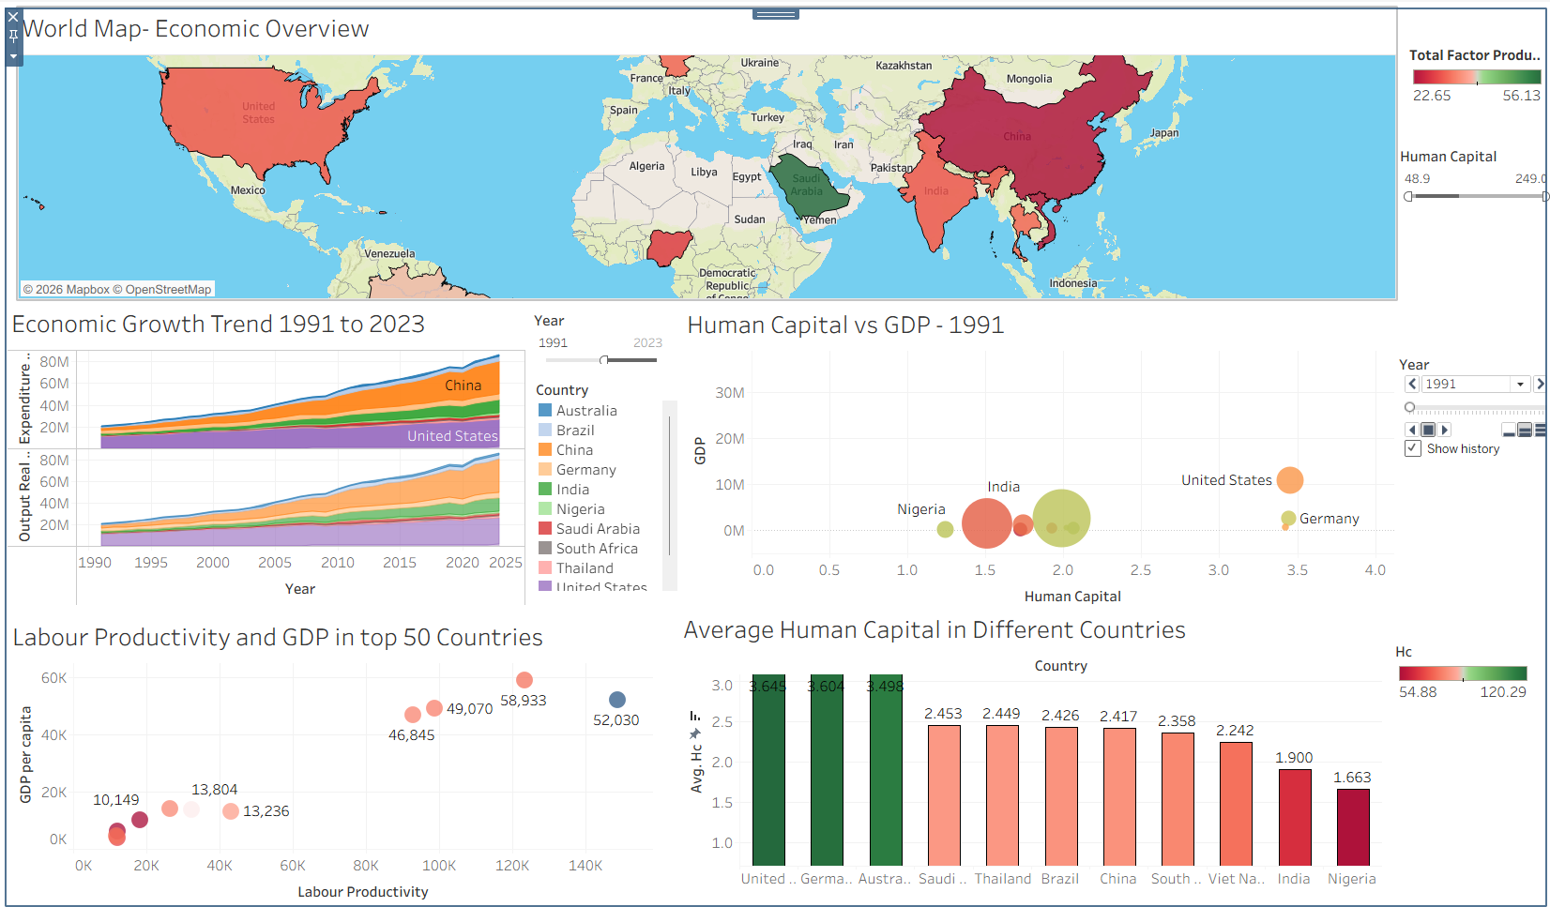

Dashboard Evidence and Key Patterns
What the visual analysis suggests
Key Patterns
China shows the strongest long-run growth acceleration
The United States remains the overall scale leader
Human capital appears positively related to GDP outcomes
Labour productivity shows a strong positive relationship with GDP per capita
United States, Germany, and Australia stand out on average human capital
Nigeria appears to have the lowest average human capital among the compared countries
India has the largest market scale but lower human capital (1.90) and labour productivity (~62.7) compared to developed economies.
India offers strong long-term growth potential but carries higher near-term execution risk, requiring a multi-indicator assessment beyond GDP or population.
INSIGHT Sustainable market attractiveness is driven by a combination of size, productivity, and talent depth.
3

Slide 4





Country Attractiveness Insights
Which countries appear strongest for expansion readiness
Average Human Capital by Country
United States
Germany
Strongest all-round profile: scale, productivity, human capital, and purchasing power
Highly attractive due to strong human capital and productivity
Australia
China
Smaller scale but strong capability and high-value market profile
Attractive for scale and growth; assess alongside productivity and capability
India
Nigeria
Major scale opportunity; lower per-capita and productivity signal near-term execution risk
Long-term potential; weaker human capital signals higher market-entry complexity
INSIGHT Countries that perform well across multiple KPIs are more attractive than countries that are large on GDP alone.
4

Slide 5


Conclusion and Strategic Recommendation
Implications for market entry decisions
The observed patterns support H1
Closing Insight
GDP is important, but insufficient as a standalone measure of market attractiveness
Human capital and labour productivity are especially important in identifying stronger expansion markets
GDP per capita adds a purchasing-power lens that sharpens market prioritization
Look Beyond GDP: Scale and productivity diverge sharply; relying solely on market size is risky.
Leverage Human Capital: It is a stronger differentiator for structural health than GDP per capita.
Match Strategy to Structure: High-scale, low-productivity markets require phased entry rather than instant expansion.
Track Productivity for Timing: Productivity gains are a reliable leading indicator of rising purchasing power.
Scorecards Dictate How, Not Just If: A scorecard must reveal why a market is attractive to shape the right entry execution.
Recommended Screening Framework
Market scale
Purchasing power
Human capital
Labour productivity
Investment support
Total factor productivity
5

